Slide 1
Downloadable Application Module SIM7000 open threadx platform

Slide 2

DAM
Resource
CPU: Cortex-A7
OS: ThreadX
App Size:
CODE + DATA = 1 Mbytes.
Flash file system = 1 Mbytes.
App Driver :
GPIO : 11
UART: 2
ADC : 1 Ch:15Bit 0.1~ 1.7V
USB : 1
I2C : 1
App Debug :
Log : UART_TX
SDK Environment
ARM Compiler 5.05 https://silver.arm.com/browse/DS500
License get from
https://silver.arm.com/browse/DS500-BN-00003
Compile command:
build.sh (Linux),
build.cm (Windows).
Customer need to modify TOOLCHAIN_PATH and ARMLMD_LICENSE_FILE in build.cmd file accordingly.

Slide 3
How to Compile Project
1) ARM Compiler 5.05 installation;
2) get license, and put it to arm folder;
3) modify build.cmd for toolchain path and license path;
4) run build.cmd in command line.

Slide 4
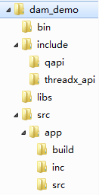

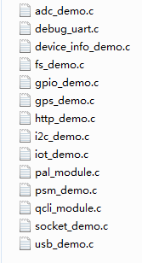
Project Tree
This is target bin file for application

Slide 5
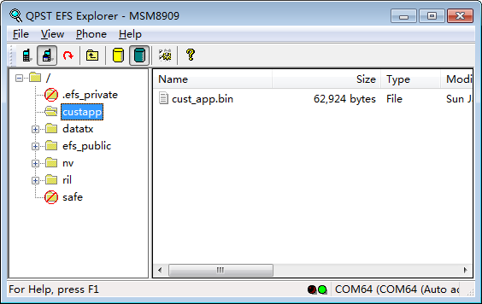
How to input app(bin) file
USB interface
QPST->EFS
AP file system
Create folder “custapp”
Put app bin file here.

Slide 6
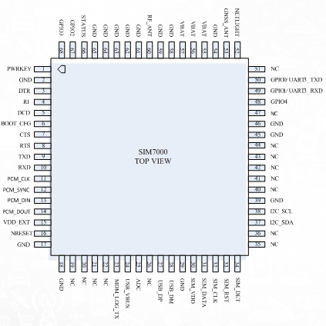
GPIO Drive Demo
Drive Pin 66 = Status
Uart3 for command input

Slide 7
1
Command List:
Commands:
1. Help
2. Exit
Subgroups:
3. PSM
4. HTTP
5. GPIO
6. ADC
7. I2C
8. FS
9. USB
10. IOT
11. SOCKET
12. GPS
> 5
GPIO> 1
Command List (GPIO):
Commands:
1. Help
2. Up
3. Root
4. GPIOINT REGISTER INTERRUPT
5. GPIOINT DEREGISTER INTERRUPT
6. GPIOINT SET TRIGGER
7. GPIOINT ENABLE INTERRUPT
8. GPIOINT DISABLE INTERRUPT
9. GPIOINT TRIGGER INTERRUPT
10. GPIOINT IS INTERRUPT PENDING
11. GET GPIO ID
12. RELEASE GPIO ID
13. CONFIG GPIO
14. DRIVE GPIO
15. READ GPIO

Slide 8
11: GET GPIO ID <pin_number>,<pin_function>,<input/output>,<pull_value>,<drive_strength> Get Gpio ID
GPIO> 11 74 0 1 0 2
GPIO: case type: QAPI_GPIO_OUTPUT_E
GPIO: case type: QAPI_GPIO_NO_PULL_E
GPIO: case type: QAPI_GPIO_6MA_E
GPIO: Result: Get Gpio ID SUCCESS
GPIO: Result: Gpio ID is 46337
GPIO> 13
GPIO: Result: Config Gpio SUCCESS
GPIO> 14 74 0
GPIO: Result: Drive Gpio SUCCESS
GPIO> 14 74 1
GPIO: Result: Drive Gpio SUCCESS
GPIO>
Get ID
Register
Drive low
Drive high

Slide 9
Thanks

